Slide 1
Missense-ical and CIN-ful projects
Kelly Brock
Takeda Group Meeting 10/9/2015

Slide 2
Ongoing projects
Predicting fitness landscapes for CIN vs non-CIN
  Using Compton lab data as “clincher” for paper from spring term
Predicting effect of missense mutations on protein structure
  Database creation
Logistics
  Hiring

Slide 3
Logistics: new student hire
Received 16 completed applications/exams!
Interviewing today, goal is to have team in place by Monday for onboarding

Slide 4

CIN as aneuploidy diffusion governed by fitness landscape
Diffusion term affected by CIN error rate μ
Chromosome distribution growth according to fitness landscape F(x)

Slide 5
Predicting fitness landscapes for CIN vs non-CIN
Marianna’s data: chromosome histograms for 10 and 1-5-19 at different timepoints via FISH
Appeared to be in steady-state
Use equation to extract fitness landscapes
Now: have SKY data (full chromosomes), but for fewer timepoints

Slide 6
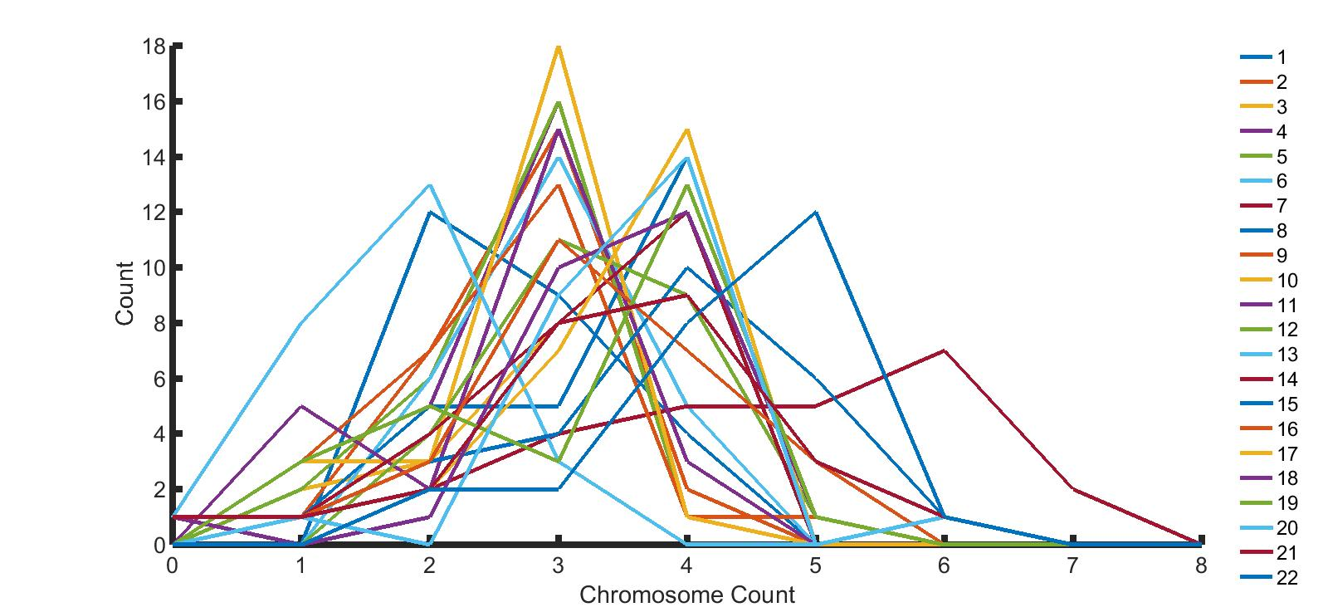
SKY data for 25 cells – chromosome-specific distributions

Slide 7
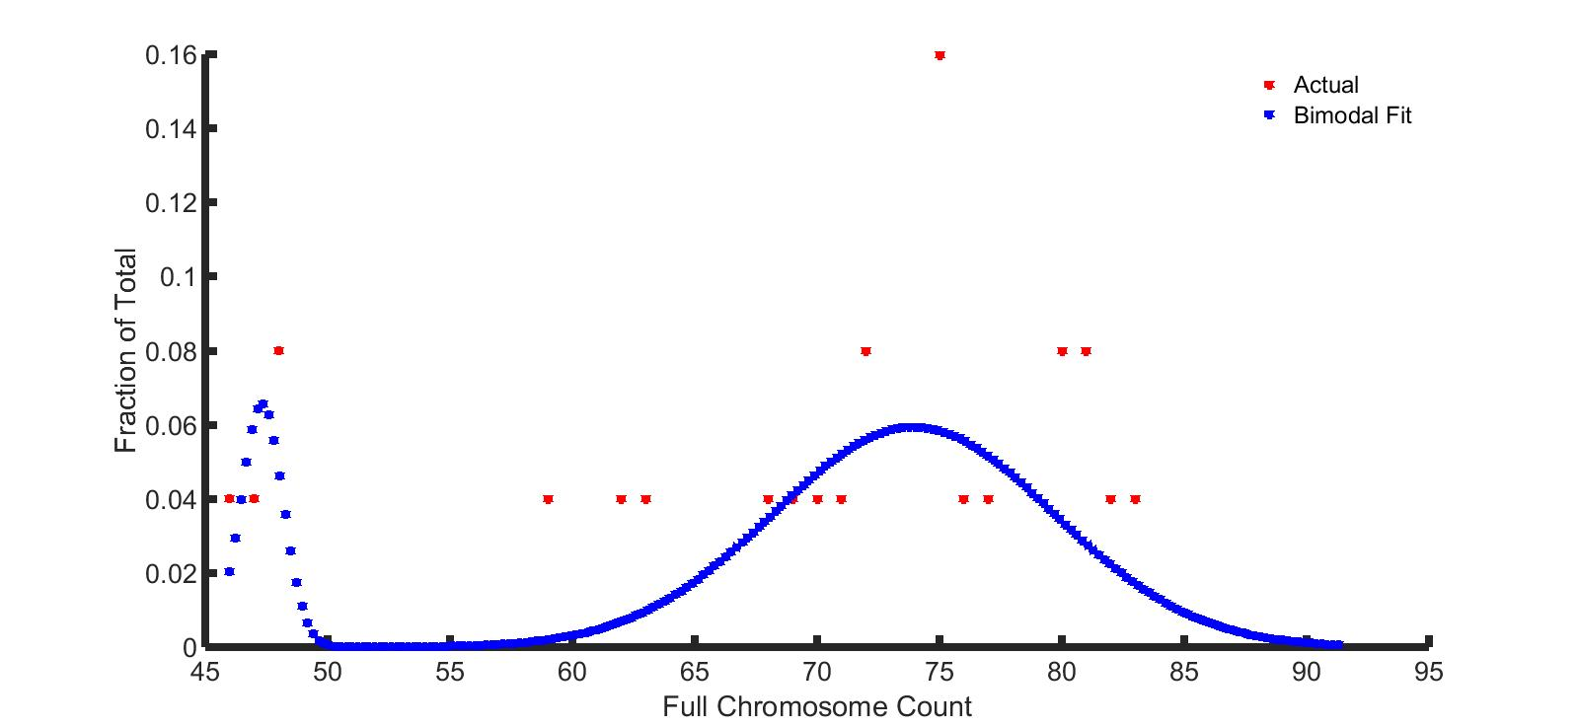
Full distribution can be difficult to fit

Slide 8
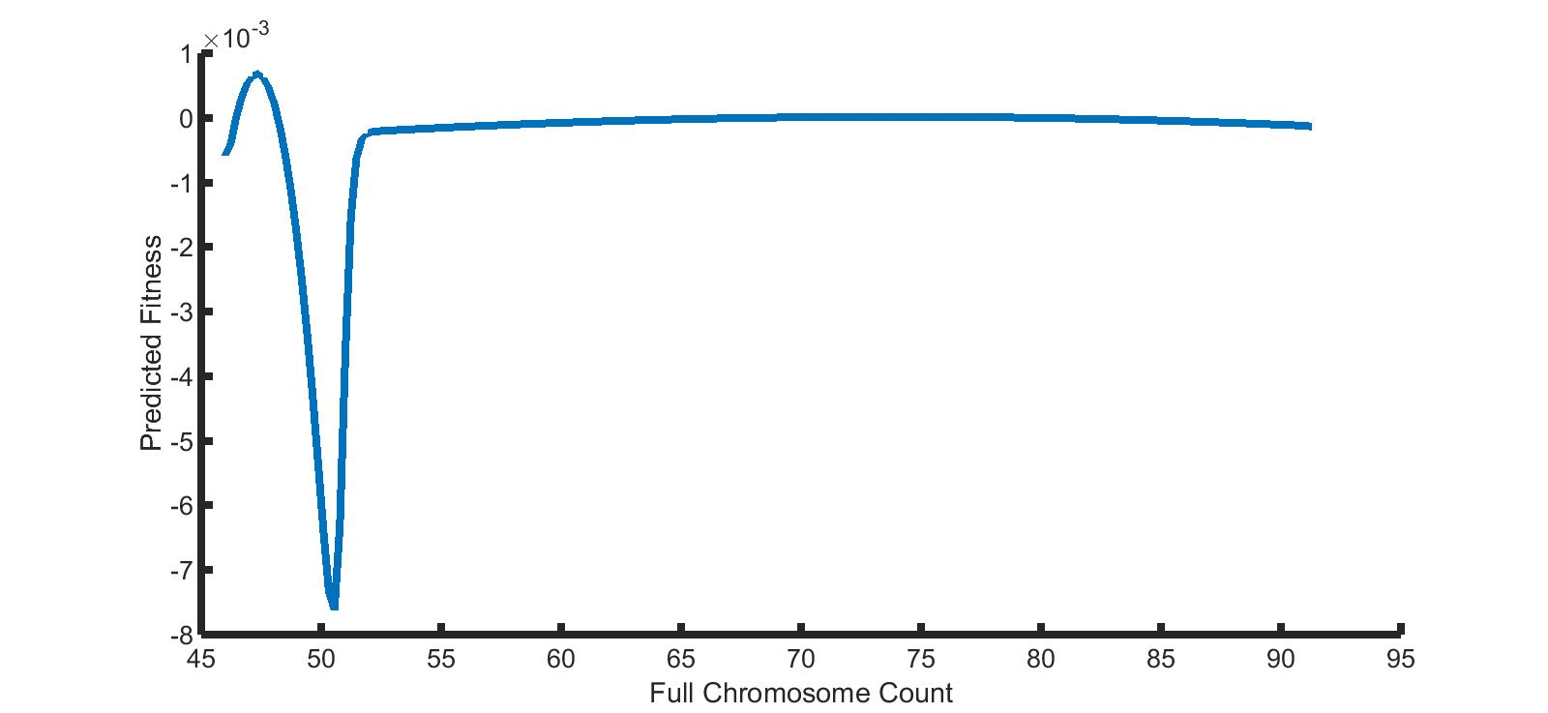
Predicted fitness landscape – potential explanation for tetraploidy initiation?

Slide 9
CIN-derived aneuploidy state can proceed through tetraploidy
Storchova and Kuffer 2008
  http://jcs.biologists.org/content/121/23/3859.full
  Tetraploidy associated with increased CIN levels (http://www.ncbi.nlm.nih.gov/pubmed/18813350)
  Tetraploidy can be a precursor to increased CIN
  Our results consistent with tetraploidy “pushing” cells into flatter landscape
Beyond distinguishing CIN from non-CIN, fitness landscapes can help us understand how CIN arises and becomes more drug-resistant

Slide 10
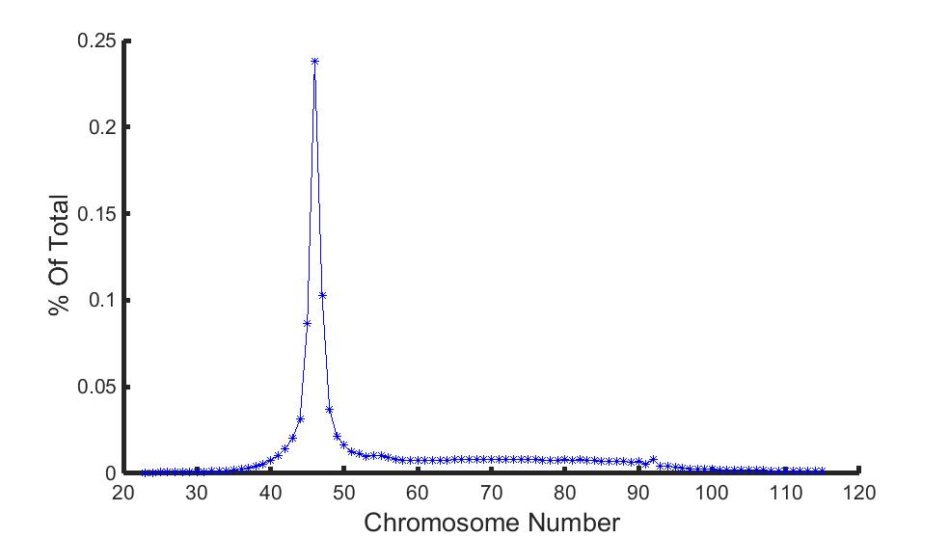
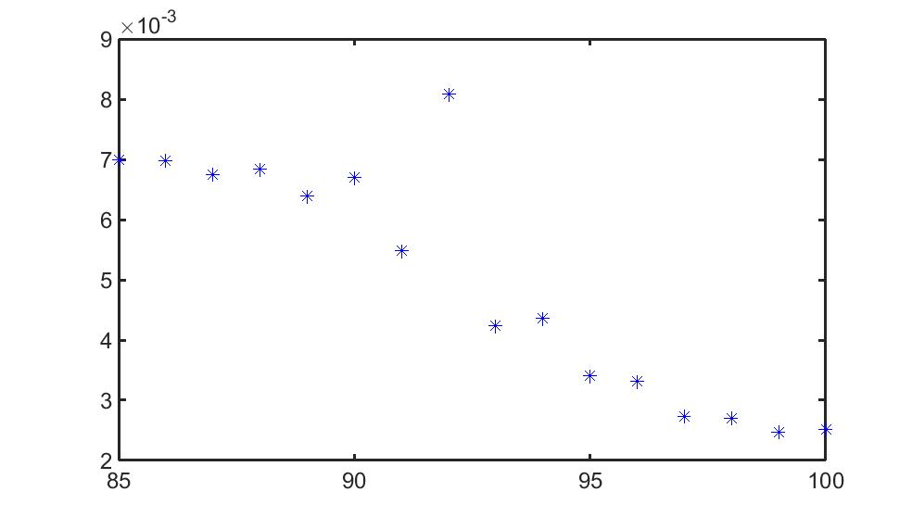
Aneuploidy distribution across multiple tumor database
"Mitelman Database of Chromosome Aberrations and Gene Fusions in Cancer (2015). Mitelman F, Johansson B and Mertens F (Eds.), http://cgap.nci.nih.gov/Chromosomes/Mitelman"

Slide 11
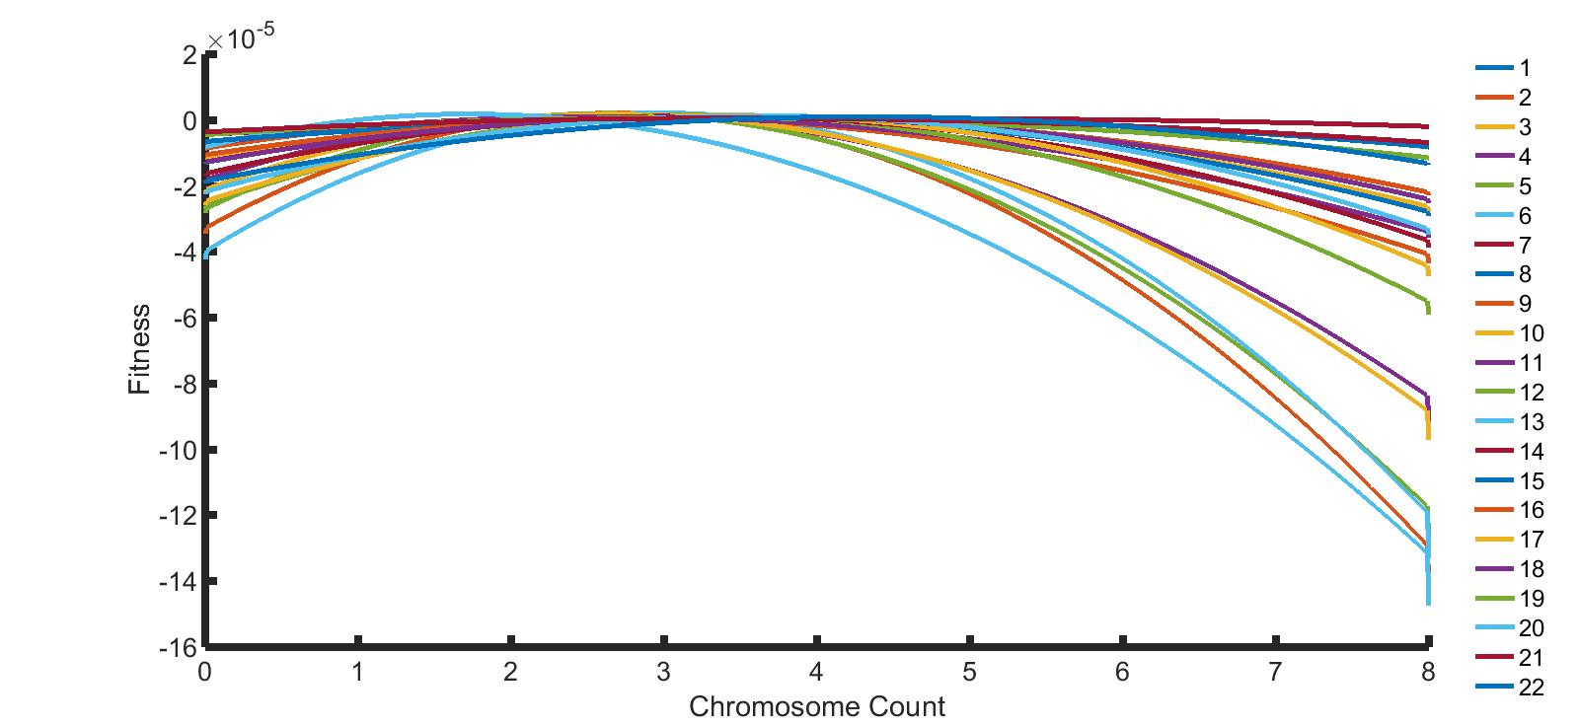
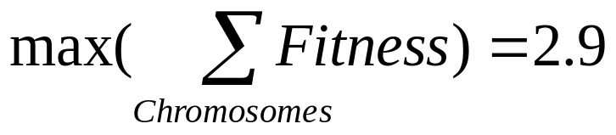
Fitness landscapes for individual chromosomes

Slide 12
Next steps
Less data points than Marianna’s set
  Normal doesn’t fit as well – more susceptible to fluctuations
  Follow up on 3N/4N
  Finish writing!

Slide 13
New project: missense mutations and structural alterations
Pain point for NGS team: which non-trivial SNPs actually have structural effect on protein product?
First step: build database of experimental functional/structural assays for missense mutations
  Status: BRCA1 ~20 missense mutations, still looking for others

